Slide 1
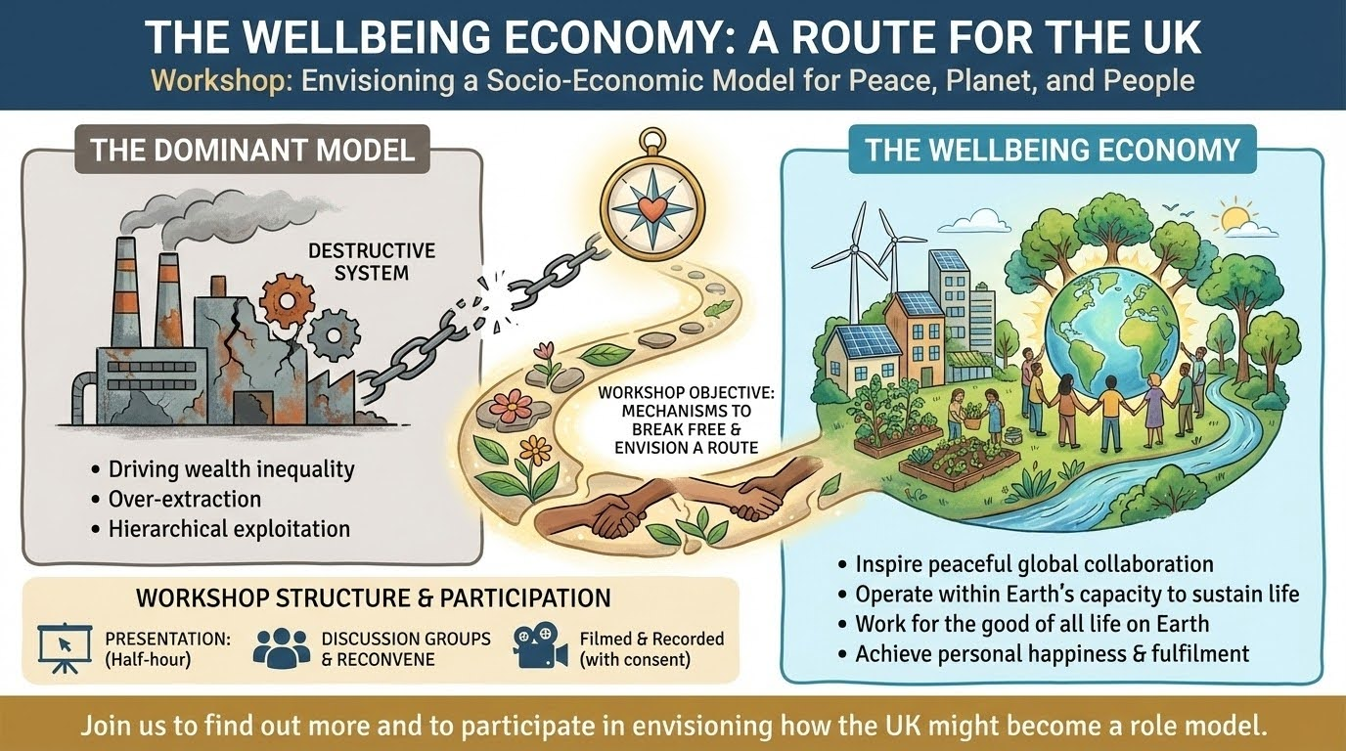

Slide 2
Step 1 is to accept the
Existential Reality

Slide 3
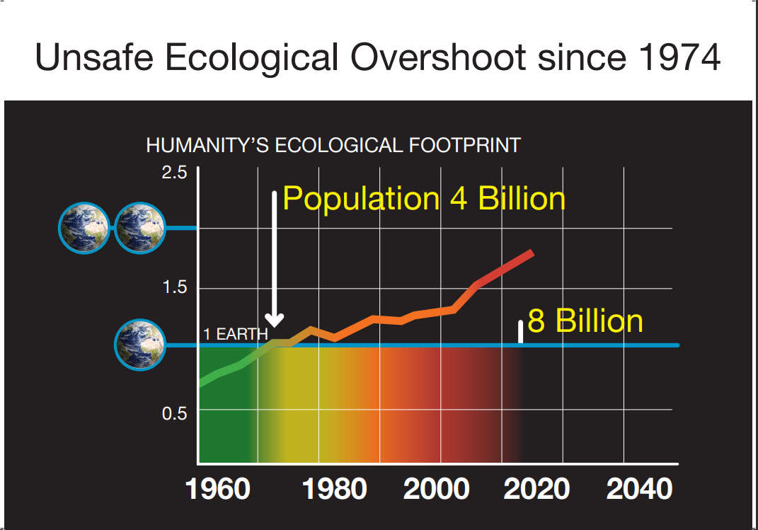

Slide 4
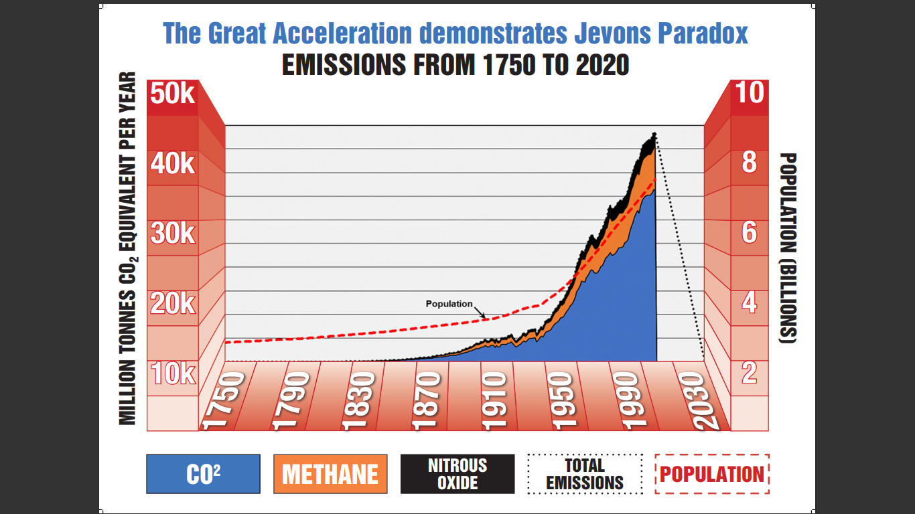
2050

Slide 5
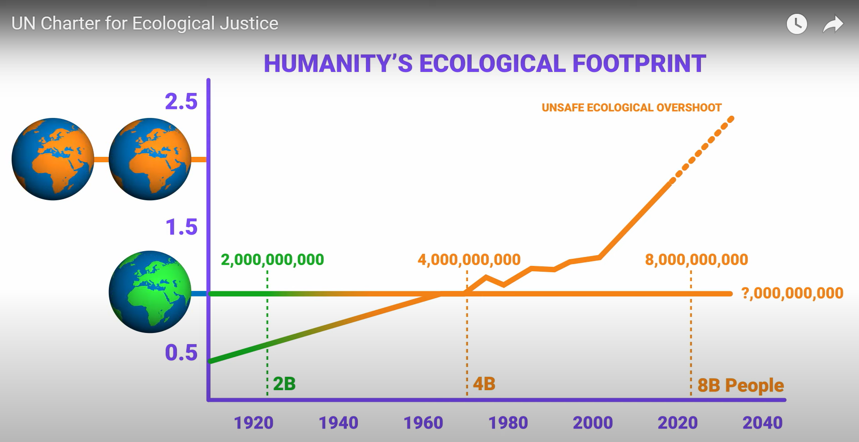

Slide 6
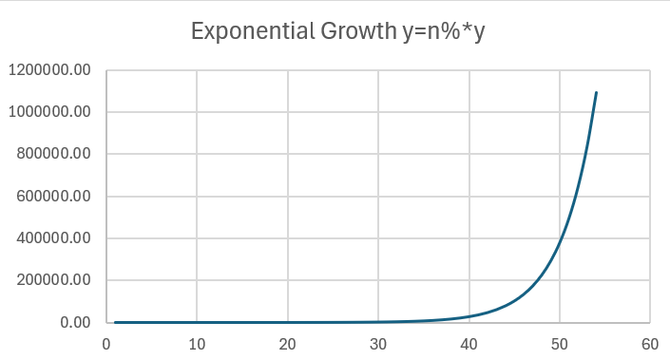
Doubling Time ≈
Divide by
(Percentage Growth Rate)
Earth’s biocapacity is ~ 12 billion global hectares
Human population is ~ 8 billion global hectares
Human usage is over 20 billion global hectares

Slide 7
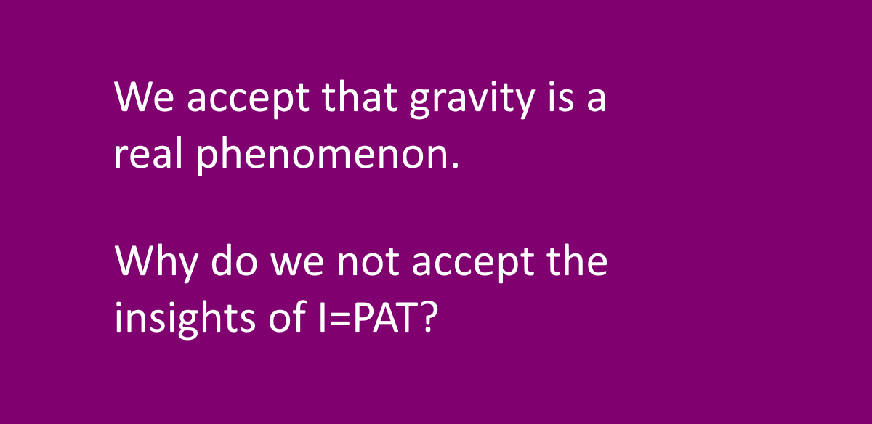
Accepting Reality

Slide 8
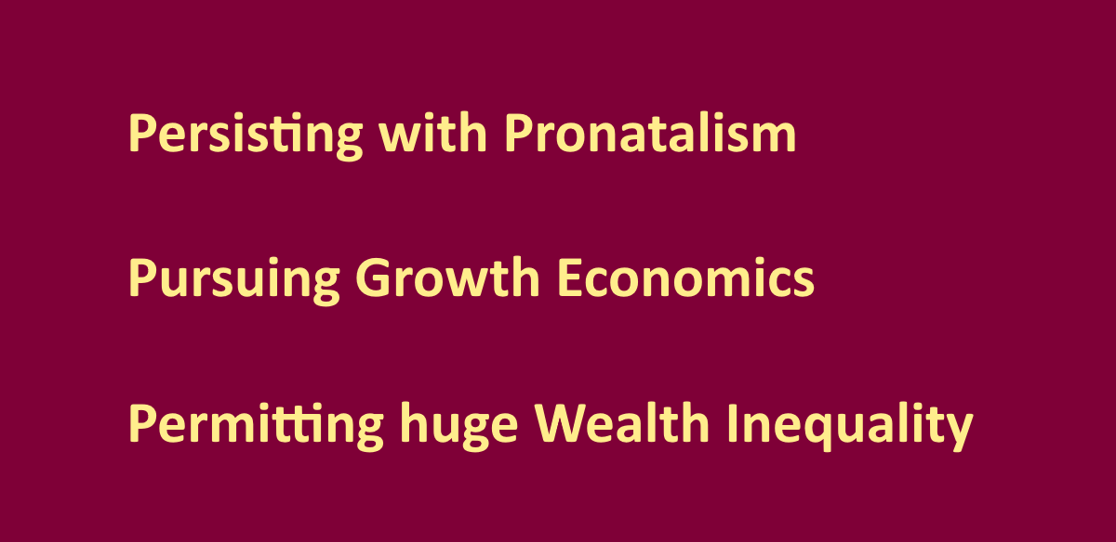
Collective Unwise Behaviour

Slide 9
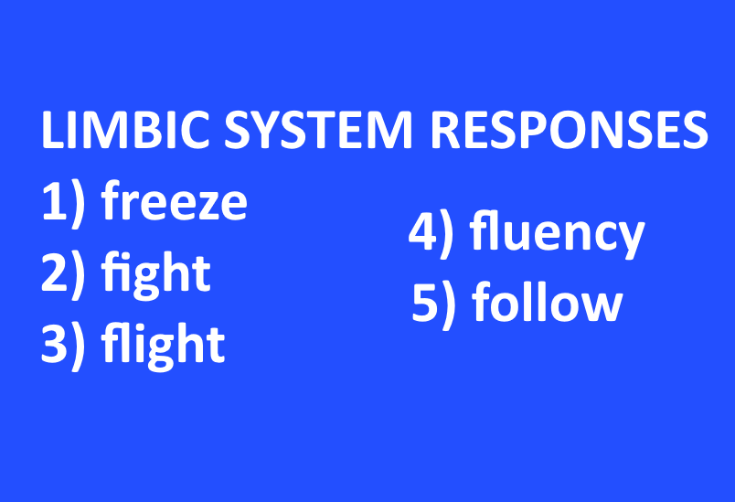
The Limbic System Responses

Slide 10


Slide 11
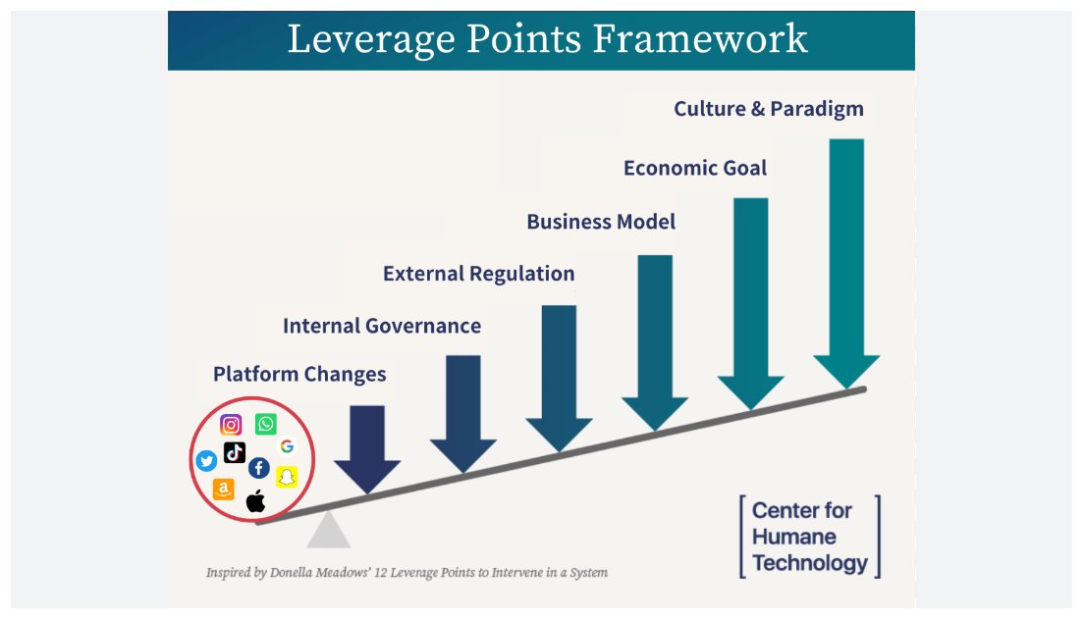

Slide 12
Unattainable Combination of Aspirations
Wise or Helpful
Unwise or Unhelpful
Human Rights
International Laws Against Genocide
Paris Climate Target 1.5 degrees
Sustainable Development Goals
Net-zero by 2050
Spiritual Wellbeing
Exponential GDP Growth
Pronatalism (most faiths)
Growing Wealth Inequality

Slide 13
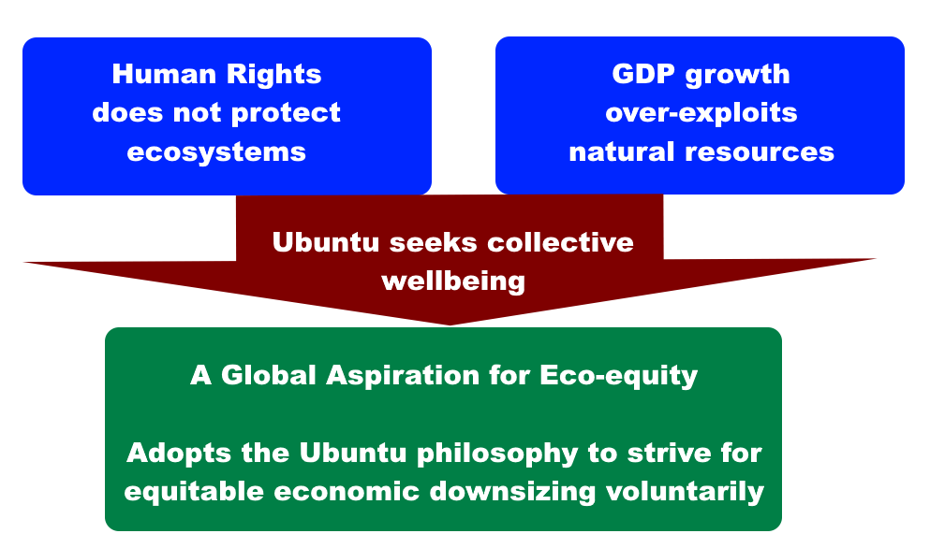
A Global Aspiration for Eco-Equity

Slide 14


Slide 15
Common Sense or Wisdom
We can only make the world we want if we keep within the biophysical boundaries of Earth.

Slide 16
Things like Y2K and the Ozone layer didn’t get to an apocalyptic point precisely because alarm bells were raised about them in time, on a sufficient scale to produce general political will for concerted action? Raising such an alarm is what scientists -and their followers such as Barbara - are doing now, for the same purpose.
Malthus couldn’t anticipate modern birth control methods, nor the degree to which food production could be increased, nor indeed the environmental consequences of overpopulation * consumption * misapplied technology. But he highlighted the basic truth that human beings have a constant tendency to expand beyond sustainability point, reproductively as well as in other ways. That is a profound basic truth, though it has worked itself out in different ways and more complex than Malthus could have anticipated.
And the same sort of thing is true about the other alarm raisers such as Paul Erhlich. It’s immaterial to us that Professor Paul Ehrlich underestimated the potential of Technology and failed to anticipate the Green Revolution, because his basic principle is profoundly true: expanded global ability to feed 8 billion people has only been achieved at punitive environmental cost such as soil and water degradation, pesticide pollution, etc, due to intensive agribusiness farming, overfishing, destruction of rainforest from soya farming, etc. And the Technology factor has intensified overconsumption, and hence Impact.
Predictions never happen in quite the simplistic way envisaged at the time, but they are not alarmist: they simply work out in more complex ways. Famines and serious malnourishment continues, in ways that could be avoidable but aren’t avoided, for political reasons. Population pressure is an indirect driver of ethnic, territorial and resource conflicts which leads to war hotspots and resultant famines.

Slide 17
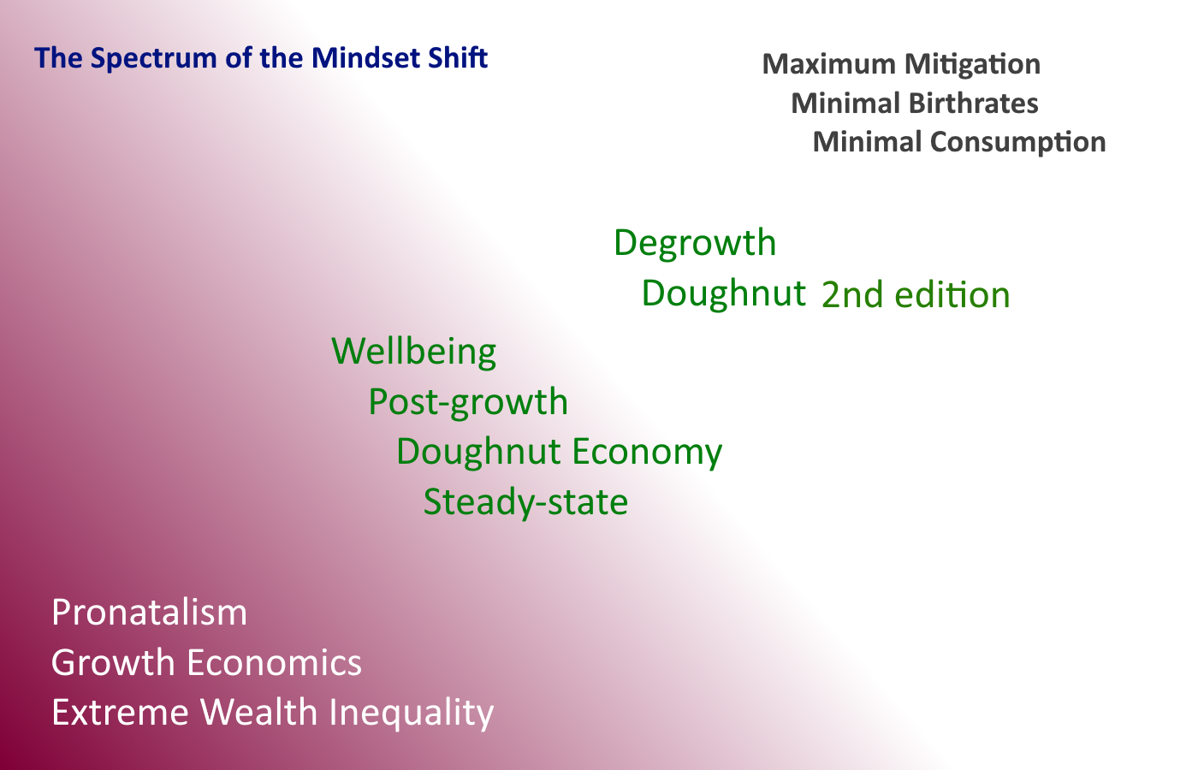

Slide 18
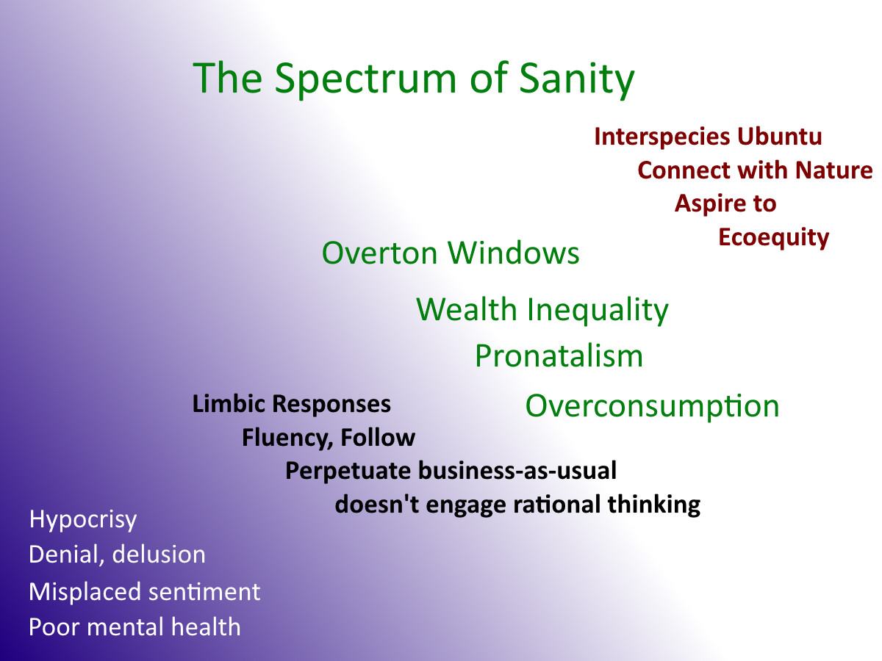
Eco triumphs
over ego

Slide 19


Slide 20
Wasted Resources
Brexit
Christmas
The Drinks Industry
The Fashion Industry
Our Judicial System
Non-essential Travel
SUVs

Slide 21
Wasted Skills and Qualities
Democracy
War
Empowerment
Ingenuity
Eco-costly Healthcare
Imbalance of Sentiment
Time and Energy

Slide 22
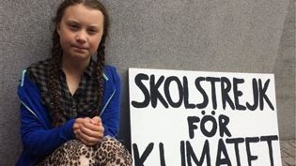
“No-one is too small to make a Difference”

Slide 23
“To him that hath shall be given”
Matthew 13:12
Those who use and cultivate their existing blessings will receive even more abundance, while those who neglect what they have will lose even that.
We are abusing our environment severely; we stand to lose everything that we need for survival.
Right now, we are working hard in ways that destroy all our blessings. We urgently need to steer into a different direction.

